Slide 1
Introduction to BIM Module 02 – Building Envelope

Slide 2
Lesson Overview
In this lesson, students explore basics techniques for using the Autodesk® Revit® Architecture software to create a building information model of a simple structure—a one-story residence
Students will learn how to:
Model wall types and design features.
Create new wall types and edit their structure
Place and adjust the properties of doors, windows, and wall openings
Create roofs with different shapes and slopes

Slide 3
Learning Objectives
After completing this lesson, students will be able to:
Understand the methods for changing wall types and for creating new wall types with specific structures and design features
Appreciate the techniques of placing doors and windows both in regular patterns and with appropriate height properties
Explore methods for creating simple and complex roof elements modeling a variety of roof shapes and forms

Slide 4
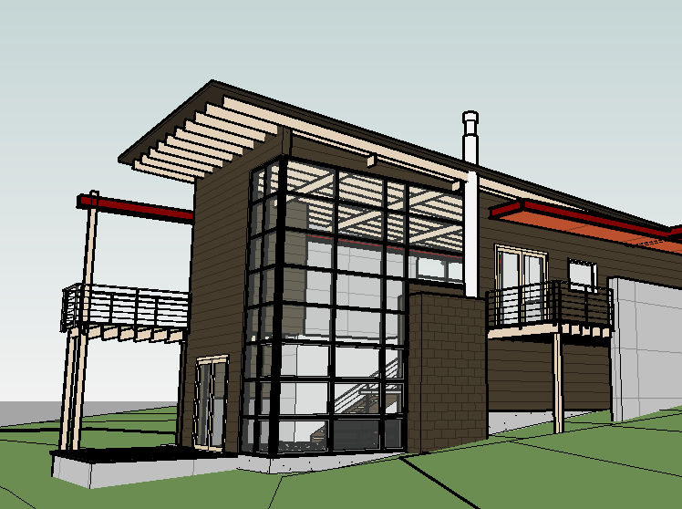
Essential Elements
Exterior Walls
Windows
Doors
Openings
Roofs
Openings
Curtain Walls
Columns

Slide 5
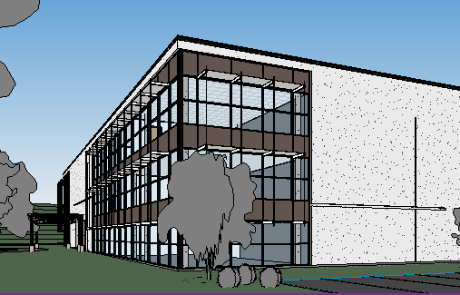
Essential Elements
Aesthetic
Mass vs. skeletal
Materials >> Sustainability
Functional
Support Loads
Separate Exterior / Interior
Thermal
Lighting / Shading
Process
Construction Technique

Slide 6
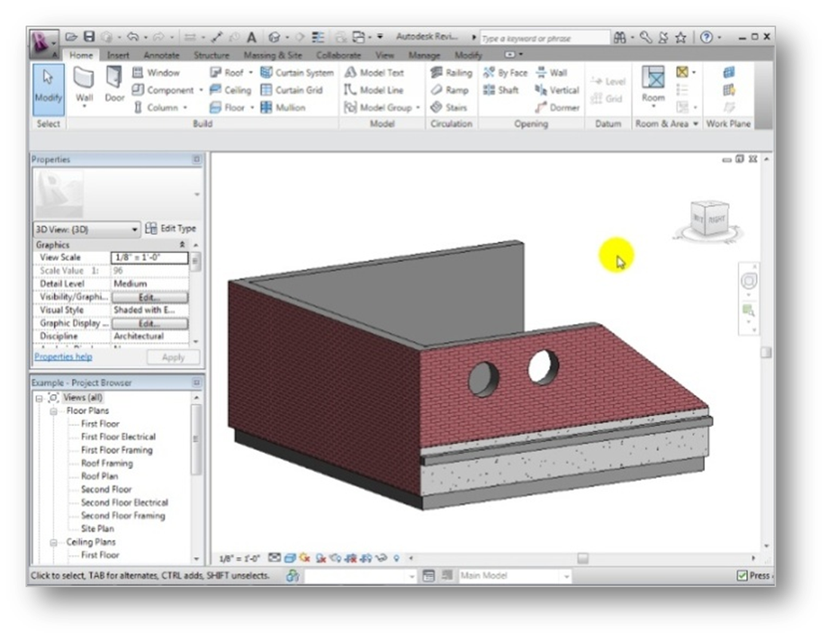
Exercise 01: Modeling Wall Types and Features
In this exercise, students will be able to:
Edit wall constraints and instance properties
Define wall structure and adjust the material wrapping settings
Add design features, such as sweeps and reveals
Use stacked wall types
Edit wall boundaries to create custom shapes

Slide 7
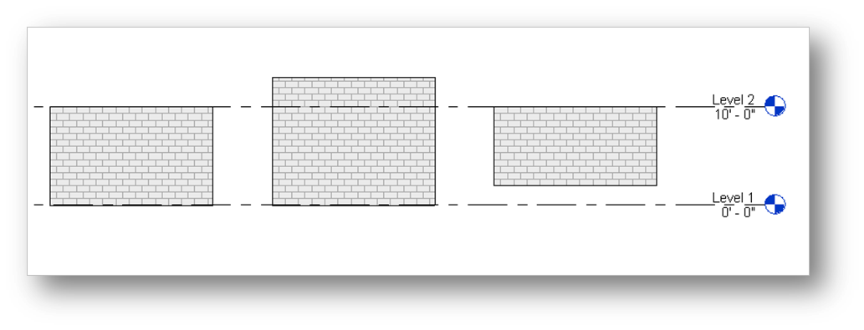
Working with Walls
Setting Instance Properties for Specific Walls
Location Line
Base
Base Constraint
Base Offset
Top
Top Constraint
Top Offset

Slide 8
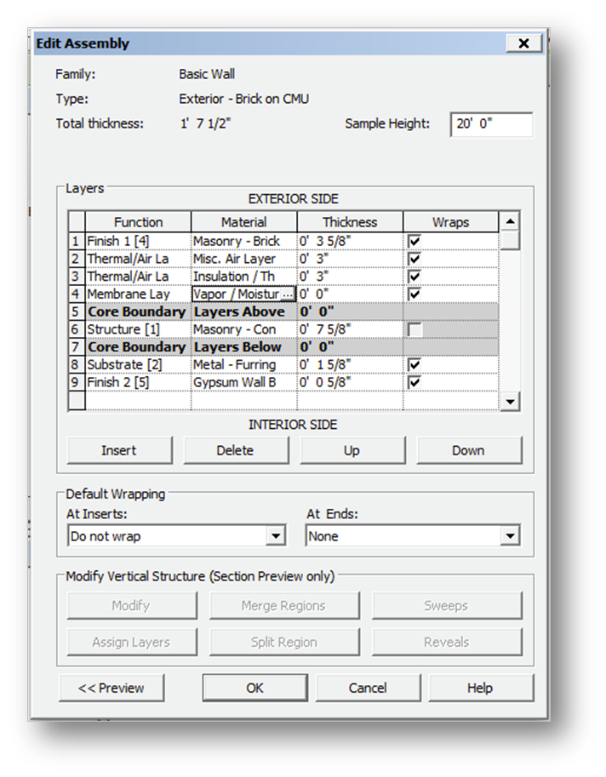
Working with Walls
Setting Type Properties for Basic Wall Types
Structure
Layers
Function
Materials
Thickness >> Total
Wrapping
Vertical Structure
Sweeps
Reveals
Regions & Layers

Slide 9
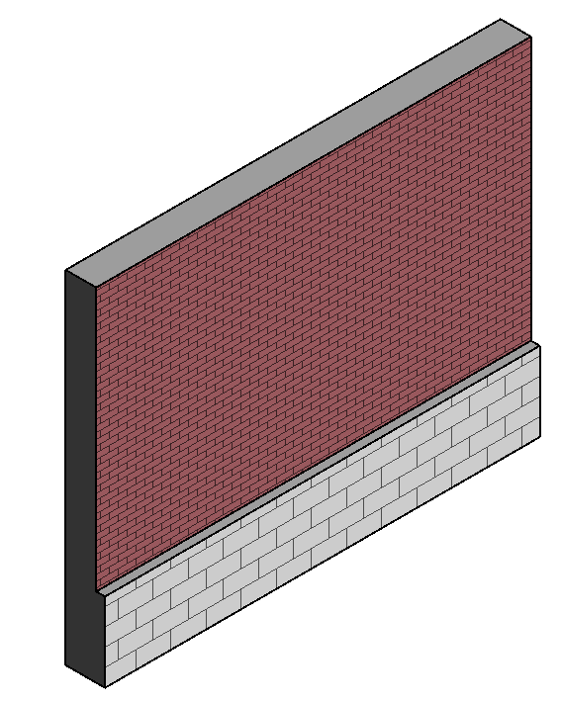
Working with Walls
Setting Type Properties for Stacked Types
Structure
Wall Type
Height
Offset
Choose which Wall Type will have variable height

Slide 10
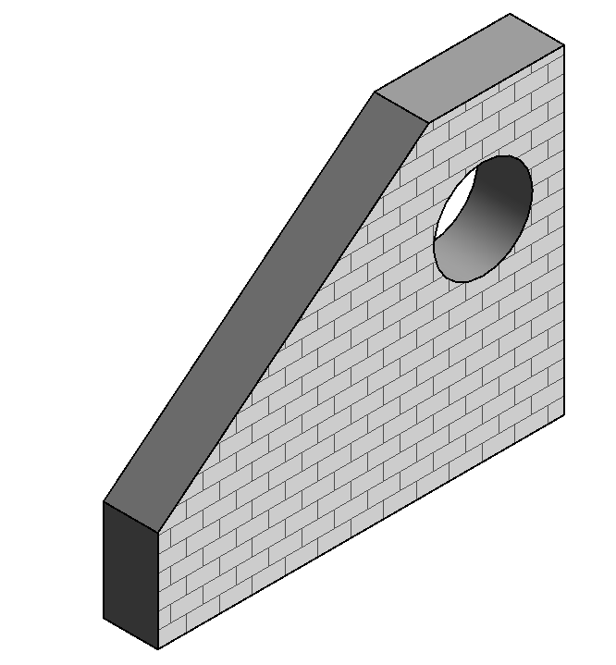
Working with Walls
Customizing Wall Boundaries
Attach or Detach wall top and bottom
Edit Wall Profile
Create a custom top profile
Pick another shape to follow
Cut a custom opening

Slide 11
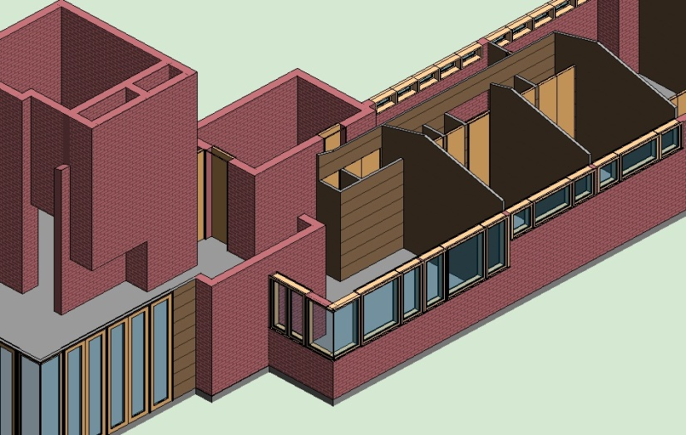
Exercise 01: Modeling Wall Types and Features
Student Exercise
Select and change the exterior walls to Exterior Brick
Create a new wall Type called Wood Panel Wall and specify the structure
Change all interior walls and exterior living room walls to type Wood Panel Wall
Attach the interior walls to the roof

Slide 12
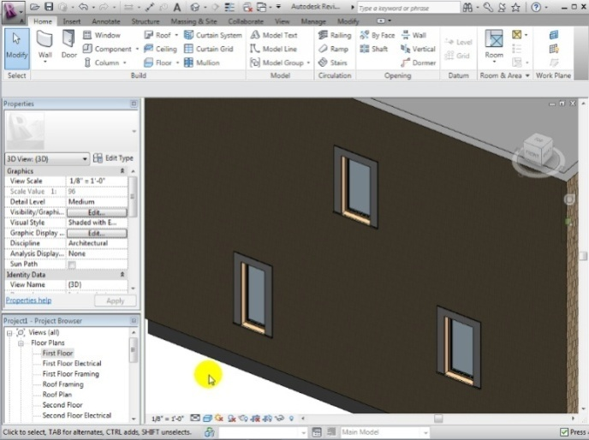
Exercise 02: Adding Doors and Windows
In this exercise, students will be able to:
Place windows and doors and change their location using temporary dimensions
Use arrays to place groups of regularly-spaced windows
Edit door and window instance properties
Create new window and door types
Create wall openings

Slide 13
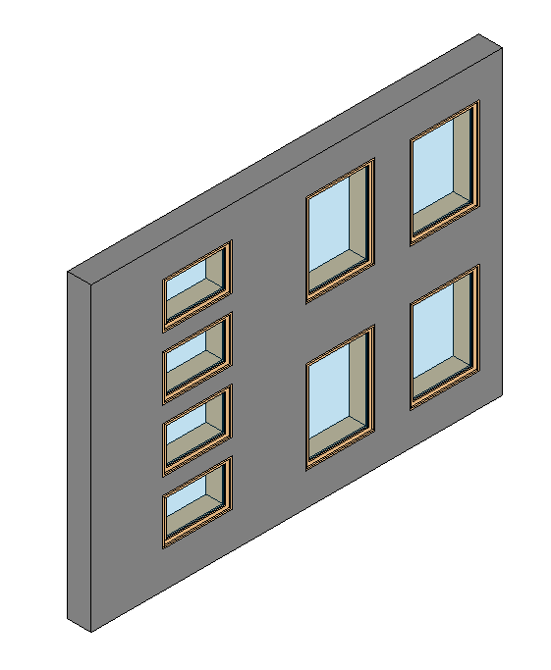
Working with Windows
Choosing Where to Place Windows
Views
Aesthetic effects
Ventilation
Lighting
Solar Radiation
Emergency Egress

Slide 14
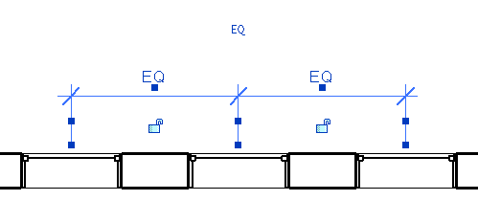
Working with Windows
Adding Windows to Your Building Model
Hosted by walls
Working with Constraints
Temporary Dimensions
Equal Constraint
Placing Groups
Grouping elements
Arraying groups

Slide 15
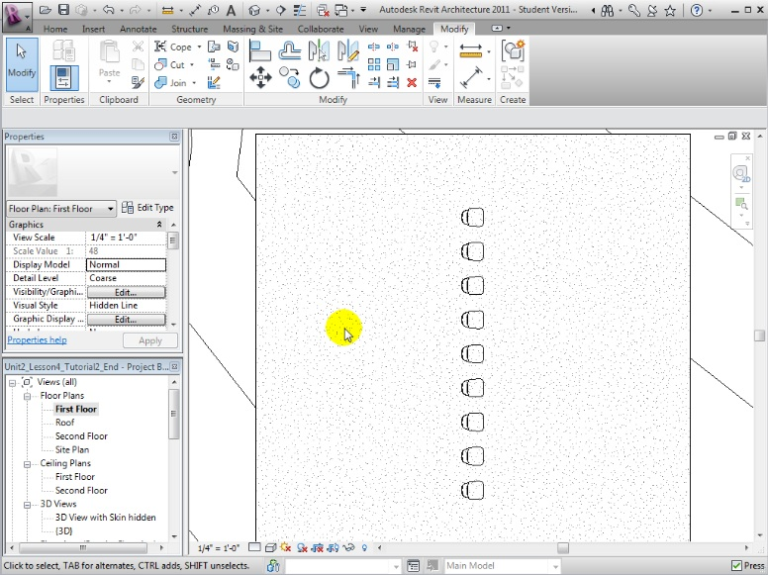
Working with Windows
Creating linear arrays of objects using Move To 2nd versus Move To Last
Select an element to array
Open the Array tool
Use the Move To 2nd option to place all instances using the offset specified
Using the Move To Last option to place all instances by dividing the distance specified equally

Slide 16
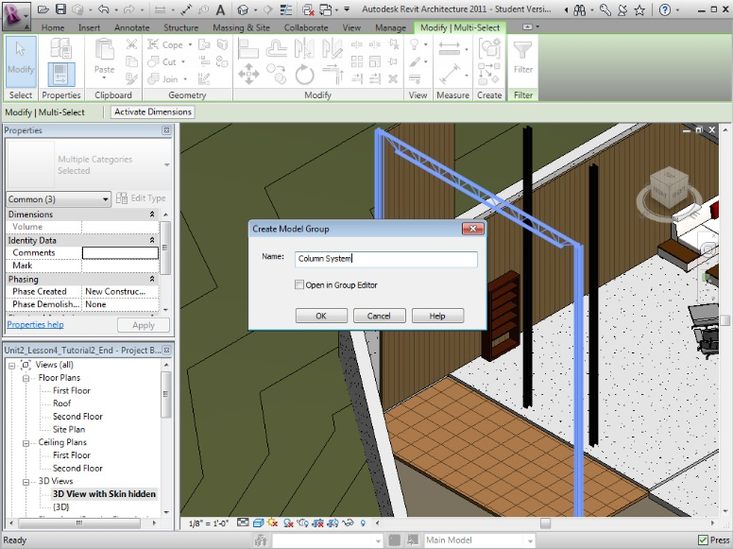
Working with Windows
Using the Group and Associate option with linear arrays
Choose the Group and Associate option to create an array of associated elements
Changes to any element in the array affect all other elements
Number of instances
Array length
Changes to the group definition

Slide 17
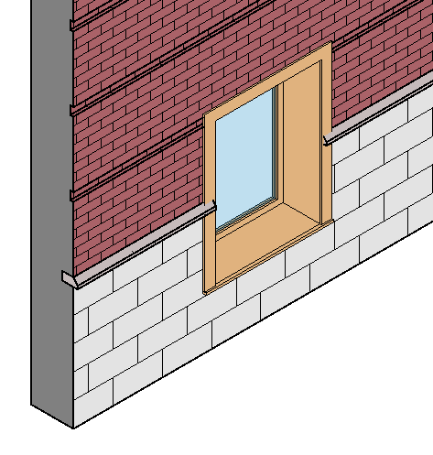
Working with Windows
Setting Window Properties
Instance Properties
Level
Sill Height
Base Height
Mark
Type Properties
Dimensions
Trim
Materials
Inset

Slide 18
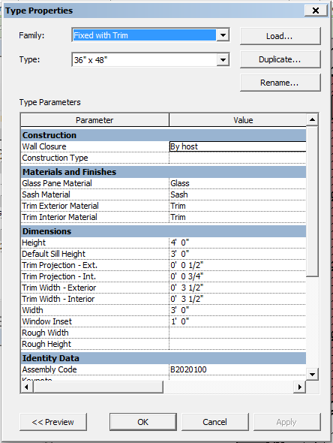
Working with Windows
Creating New Window Types
Creating New Sizes
Select similar window
Duplicate an existing type
Rename it
Adjust size parameters
Loading New Types
From libraries
Local
Web

Slide 19
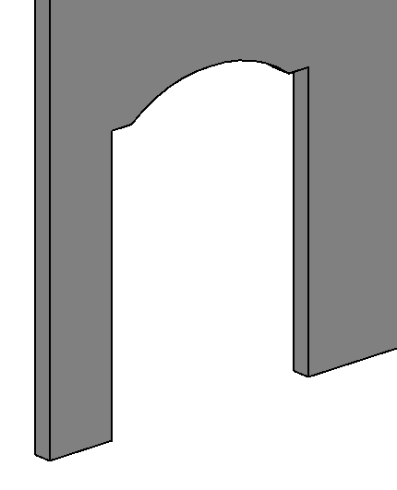
Working with Windows
Adding Wall Openings
Load opening elements from library
Use Component tool
Load Family from Door section of library
Place on wall
Adjust size parameters
Wall Opening tool
Simple rectangular openings only

Slide 20
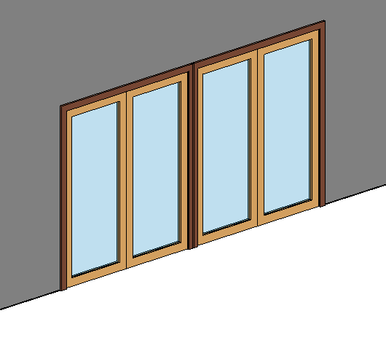
Working with Doors
Choosing Where to Place Doors
Access / Circulation
Emergency Egress
Aesthetic effects
Ventilation
Desirable
Undesirable
If glazed, then
Lighting
Solar Radiation

Slide 21
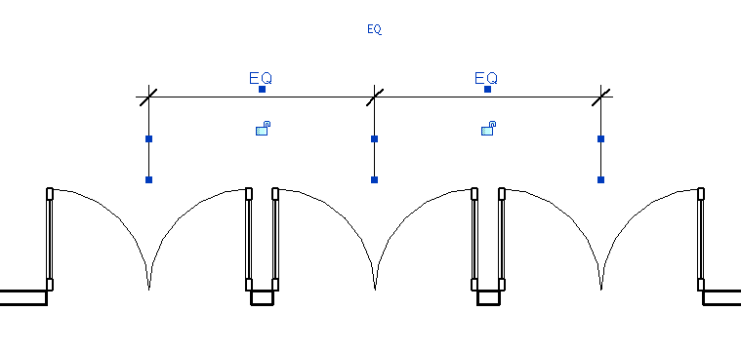
Working with Doors
Adding Doors to Your Building Model
Hosted by walls
Working with Constraints
Temporary Dimensions
Equal Constraint
Placing Groups
Grouping elements
Arraying groups

Slide 22
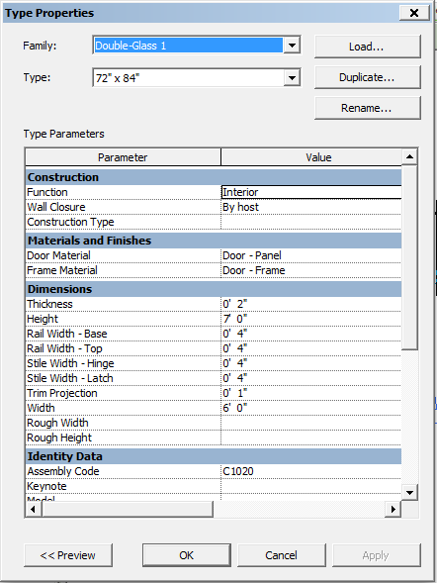
Working with Doors
Creating New Door Types
Creating New Sizes
Select similar door
Duplicate an existing type
Rename it
Adjust size parameters
Loading New Types
From libraries
Local
Web

Slide 23
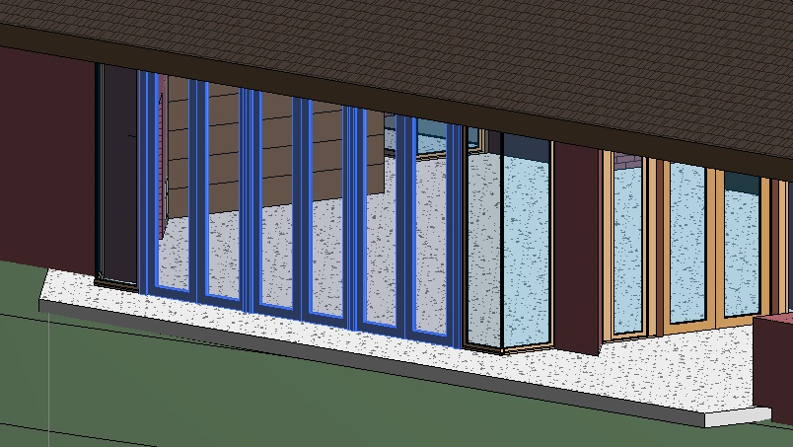
Exercise 02: Adding Doors and Windows
Student Exercise
Place a Double-Glass type door at one end of the east living room wall, and then array it to create three instances
Create similar arrays of Casement Dbl type windows in the dining and bedroom areas

Slide 24
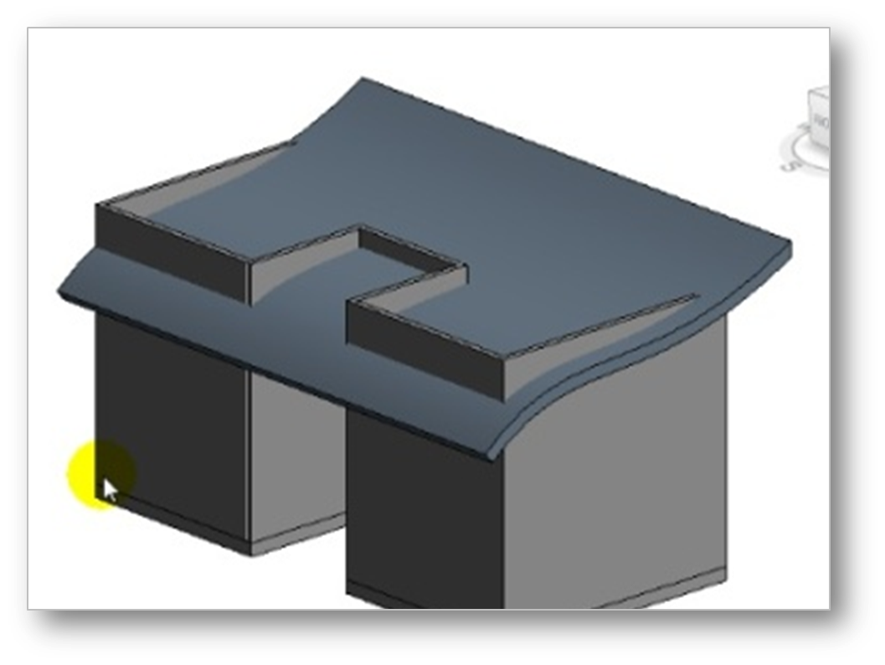
Exercise 03: Creating Roof Shapes
In this exercise, students will be able to:
Create roofs by specifying their footprint and adjusting their properties
Modify a roof footprint and slope-defining edges to fine-tune the create various roof shapes and forms
Create a custom roof form by extruding a roof surface from a sketched profile

Slide 25
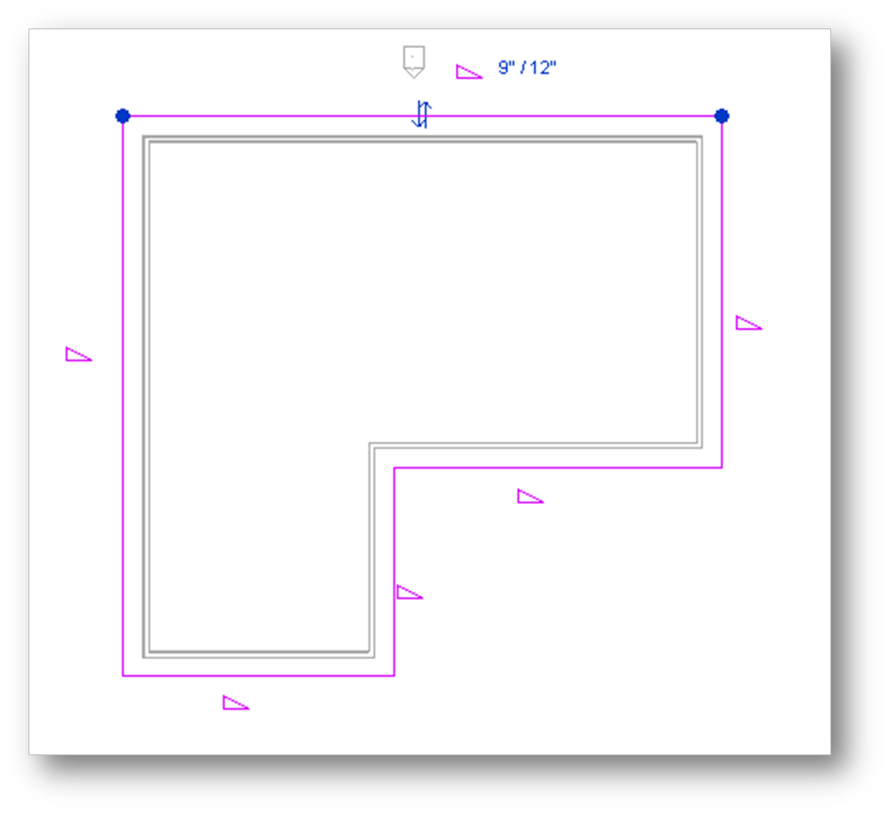
Working with Roofs
Defining Roofs by Footprint
Sketch or pick walls to define the footprint
Specify for each footprint line
Defines slope?
Overhang
Extend to wall core?
Set Base Level or Base Offset
Choose roof type
Attach walls to roof?

Slide 26
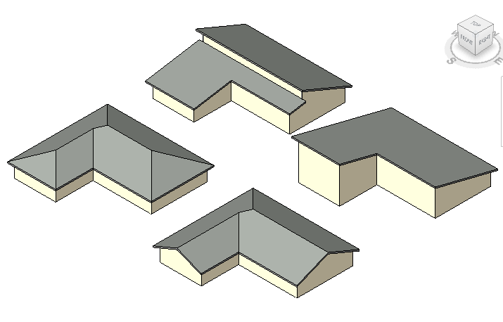
Working with Roofs
Choosing Slope Defining Edges
Hip roofs
Gable roofs
Shed roofs
Clerestory roofs
Butterfly roofs

Slide 27
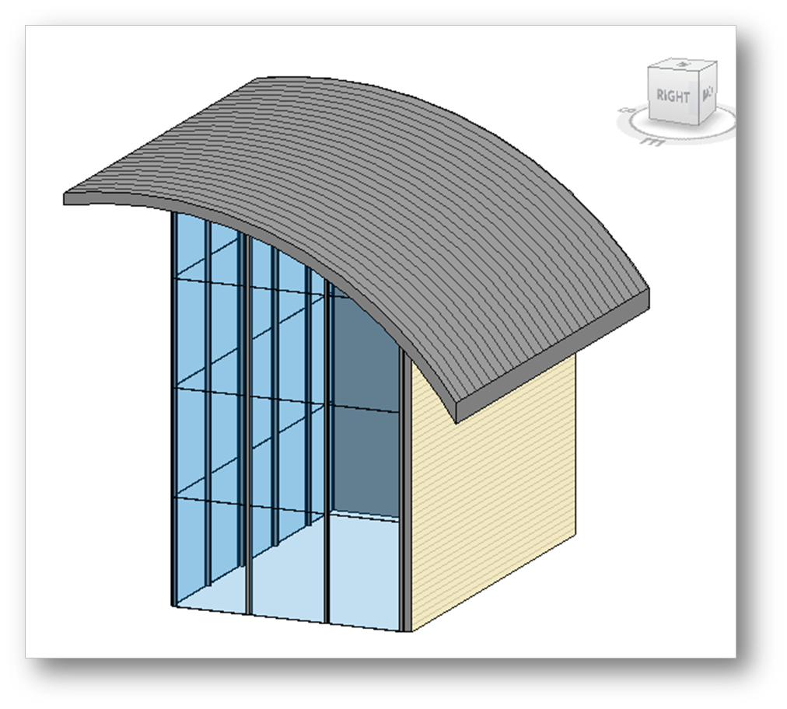
Working with Roofs
Defining Roofs by Extrusion
Create reference plane (for extrusion profile) and name it
Open Roof by Extrusion tool and choose work plane
Draw single edge of extrusion profile
Choose roof type
Adjust start and stop of extruded roof shape

Slide 28
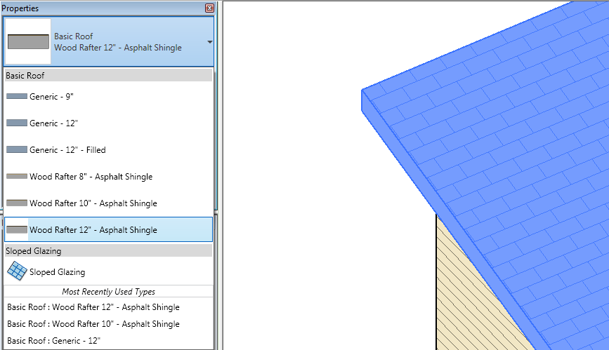
Working with Roofs
Creating New Roof Types
Duplicate an existing type
Select similar roof
Duplicate an existing type
Rename it
Adjust structure
Copy an existing type
Defined within projects
Transfer project standards
Cannot copy from library

Slide 29
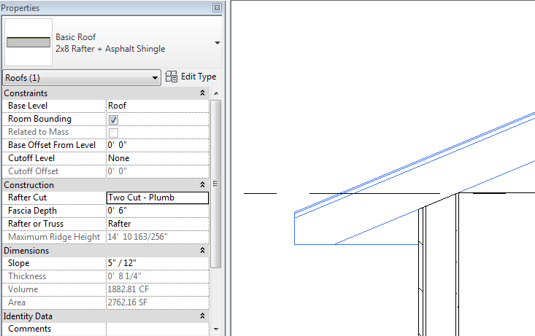
Working with Roofs
Specifying the Roof Edge Condition
Overhang
Rafter Cut
Plumb Cut
Two Cut – Plumb
Two Cut – Square
Fascia Depth
Rafter or Truss
Align eaves as needed for continuous roof edges

Slide 30
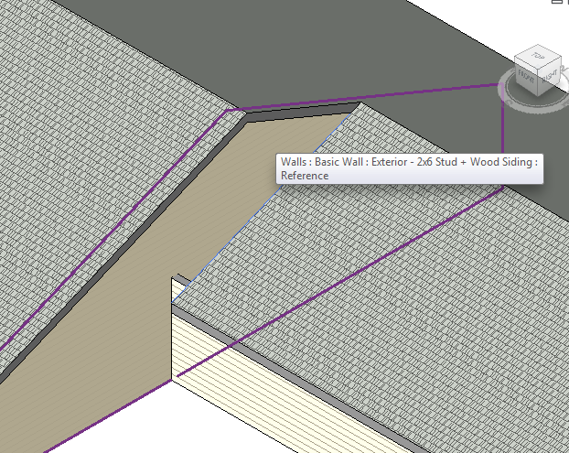
Working with Roofs
Joining Roof Elements
Attach wall to roof
Join roof edge to roof face
Join roof edge to wall

Slide 31
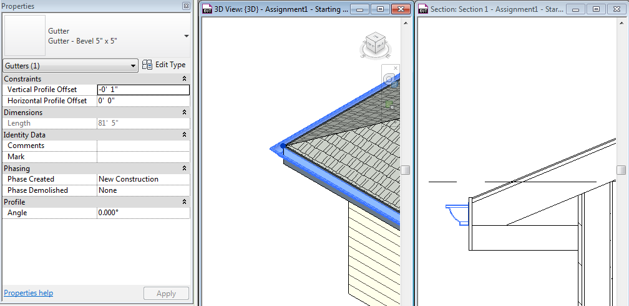
Working with Roofs
Adding Roof Edge & Eave Details
Fascia boards & gutters
Choose profile
Set offsets
Pick edges
Soffits
Sketch boundary (in reflected ceiling plan view)
Set elevation

Slide 32
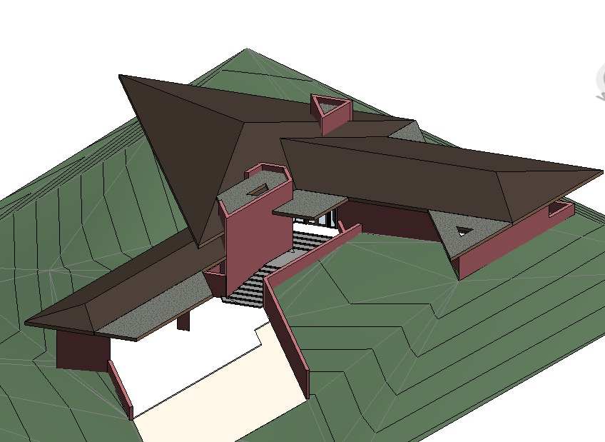
Exercise 03: Creating Roof Shapes
Student Exercise
Create a new roof by footprint over the triangular main living area of the project model
Create another roof by footprint over the southeast bedroom wing
Join the non-sloping edge of this bedroom area roof to the closest face of the living area roof to create a single roof

Slide 33
Assessment
Modeling Wall Types, Structures, and Design Features
How is the total thickness of a wall type computed?
How can changing a wall’s type affect the clear space between adjacent walls?
In a typical residence, what locations are most critically affected by the wall thickness?

Slide 34
Assessment
Adding Doors, Windows, and Wall Openings
Do the doors and windows move with the walls?
Do doors and windows automatically adjust to the thickness of the host wall?
What happens if the boundary of the door or window exceeds the extents of the wall?
Can you place a door at a height above or below the associated floor level?

Slide 35
Assessment
Creating Roof Shapes
What would be the method for creating a barrel vault roof?
How about a dome?
A sloping roof surface surrounding a lower flat roof—a strategy often used to conceal utilities and mechanical equipment?
What can you do if Revit reports that it cannot create a roof by footprint using the boundary sketched?

Slide 36
Key Terms Used
Key Term | Definition
Stacked wall | A wall that has two or more horizontal layers, each consisting of different materials and surfaces.
Wall sweep | A horizontal or vertical projection from a wall, often decorative in nature. Examples of wall sweeps include baseboards and crown molding.
Revolve | Solid geometry that turns (revolves) around an axis. For example, you can use the Revolve tool to design a dome roof, a column, or door knobs.
Reveal | A decorative cutout in a wall.
Slope defining | Characteristic referring to of a roof edge’s role in defining the roof slope.

